Slide 1
Project Presentation of Co-Op Project at Industry (Module-2)
On
Online Restaurant Website
for Food Ordering and Menu Visualization
Department of Computer Science and Engineering,
Chitkara University, Punjab

Slide 2
Introduction
In today’s fast-paced digital world, online food ordering has become an essential service for customers. People prefer browsing menus, ordering food, and making payments online instead of visiting restaurants physically.
This project focuses on developing an Online Restaurant Website that allows users to:
View food menus visually
Place orders easily
Explore dishes with images and descriptions
The system improves user experience by providing a simple, fast, and interactive platform for food ordering.
2

Slide 3
OBJECTIVES
• To design an online platform for food ordering
• To provide a clear and attractive menu visualization
• To simplify the ordering process for users
• To enhance user experience with a responsive interface
• To manage orders efficiently

Slide 4
SYSTEM OVERVIEW / MODEL USED
Instead of a model like NLLB, here we describe system:
The system is a web-based application that allows users to:
Browse restaurant menus
View images and details of food items
Add items to cart
Place orders
It follows a client-server architecture where:
Frontend handles user interaction
Backend manages data and processing

Slide 5
TOOLS AND TECHNOLOGIES
• Frontend – React.js / HTML / CSS / JavaScript
• Backend – Node.js / Express.js
• Database – SQL (MySQL)
• API Integration – For handling requests
• Development Tools – VS Code

Slide 6
FEATURES
• User-friendly interface
• Food menu with images
• Add to cart functionality
• Order placement system
• Responsive design for all devices

Slide 7
OUTCOMES
• Easy and fast food ordering system
• Better user experience through visualization
• Time-saving for customers
• Efficient restaurant management
• Scalable web application

Slide 8
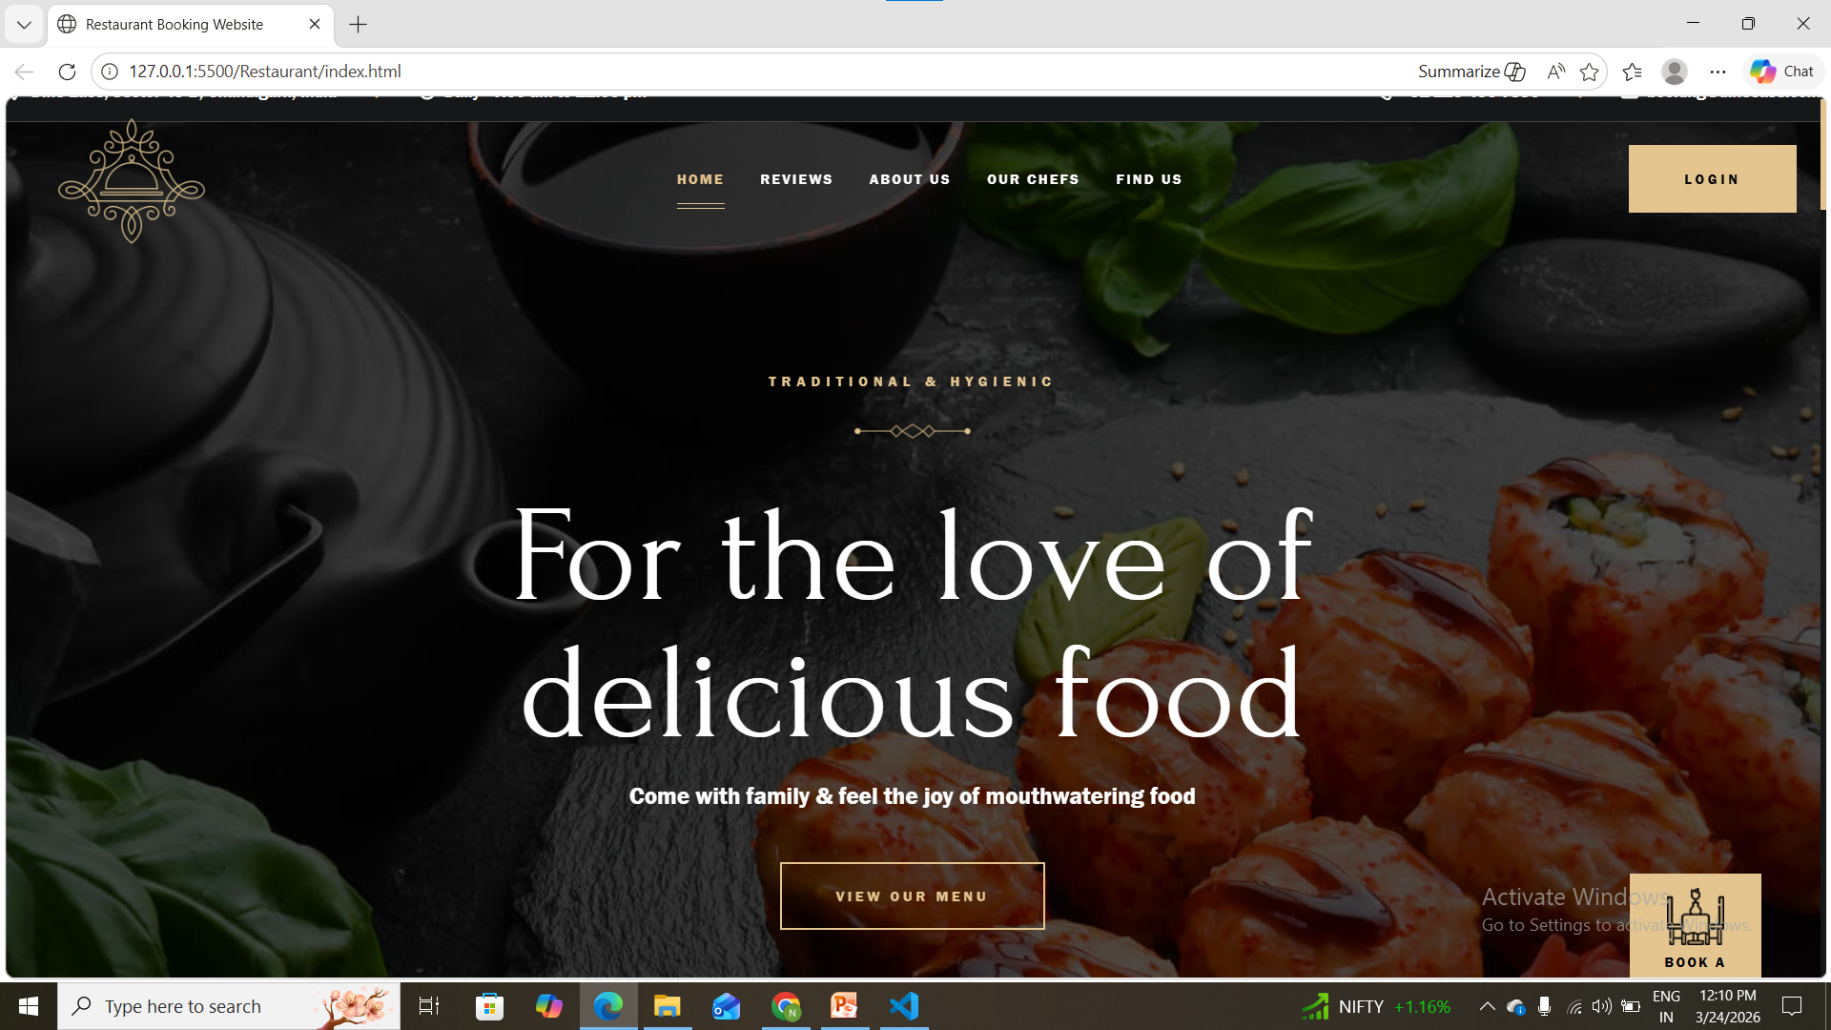
Screenshots

Slide 9
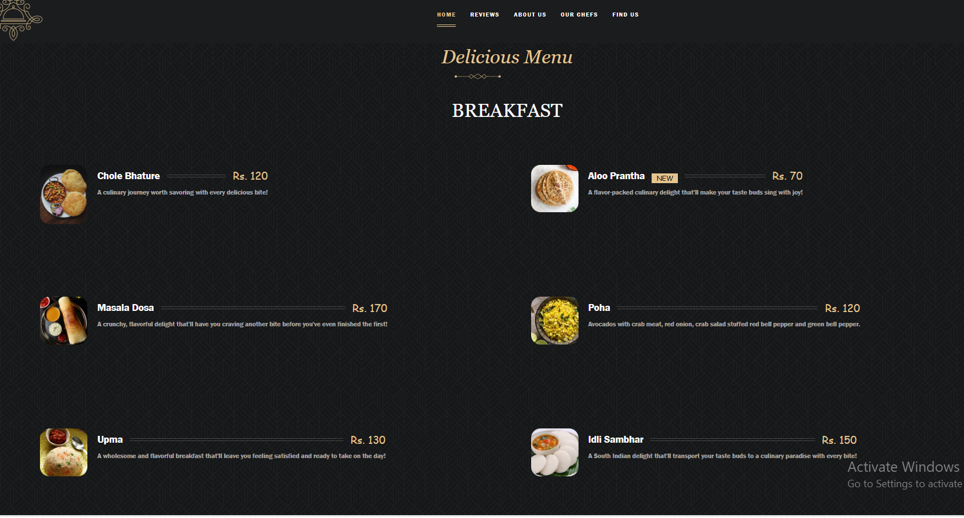
Screenshots

Slide 10
Results
The website successfully:
Displays food items with details
Allows users to add items to cart
Processes orders smoothly
Provides a clean and interactive UI

Slide 11
CONCLUSION
This project demonstrates the development of a modern online food ordering system. It shows how web technologies can be used to improve customer experience and simplify restaurant services.
The system is practical, scalable, and can be enhanced further with features like payment integration and user authentication.

Slide 12
Thank You
12

